Slide 1
Department of CSE H
Probability statistics and queuing theory
22mt2005
Topic
Probability -Introduction
Session - 1

Slide 2



AIM OF THE SESSION
To familiarize students with the basic concepts of probability
INSTRUCTIONAL OBJECTIVES
This Session is designed to:
Define the concept of probability
List out the different approaches of probability
Describe the different types of events
Discuss he importance of probability in real life applications.
LEARNING OUTCOMES
At the end of this session, you should be able to:
Define probability and its axioms
Describe the different types of events.
Summarize the concept of probability with suitable example.

Slide 3
CO INTRODUCTION
PROBABILITY
Deterministic Experiments: Everyone will get exact result.
Random Experiments: In life, we perform many experimental activities, where the result may not be same, when the experiments are repeated under identical conditions. We are not sure which one of many possible results will actually be obtained. Such experiments are called random experiments.
Probability is a measure of uncertainty of various phenomenon.
The role of probability theory is to provide a framework for analyzing phenomena with uncertain outcomes.

Slide 4
Different approaches of probability
There are three approaches:
The classical theory of probability: The probability of an event is computed as the ratio of the number of outcomes favorable to the event, to the total number of equally likely outcomes. This could be a thought experiment; example: tossing a coin; outcomes: head or tail
The statistical approach of probability: the probability on the basis of observations and collected data. The above two approaches assume that all outcomes are equally likely.
3. The axiomatic approach of probability: Here, the outcomes need not have equal chances of occurrence. We may have reason to believe that one outcome is more likely to occur than the other. In this approach, some axioms are stated to interpret probability of events.
To understand this approach, let us learn a few basic terms viz. random experiment, sample space, events

Slide 5
Random Experiment
Random experiment: In life, we perform many experimental activities, where the result may not be same, when the experiments are repeated under identical conditions. We are not sure which one of many possible results will actually be obtained. Such experiments are called random experiments.
A possible result of a random experiment is called its outcome.
An experiment is called random experiment if it satisfies the following two conditions:
(i) It has more than one possible outcome.
(ii) It is not possible to predict the outcome in advance.
Two steps in description of a random experiment:
1.Describe possible outcomes of a random experiment
2.Describe beliefs about likelihood (chance) of outcomes

Slide 6
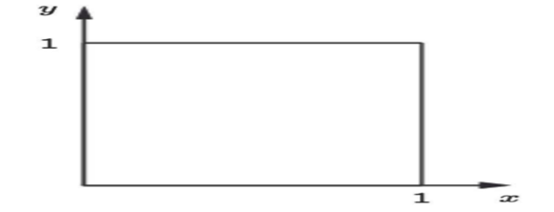
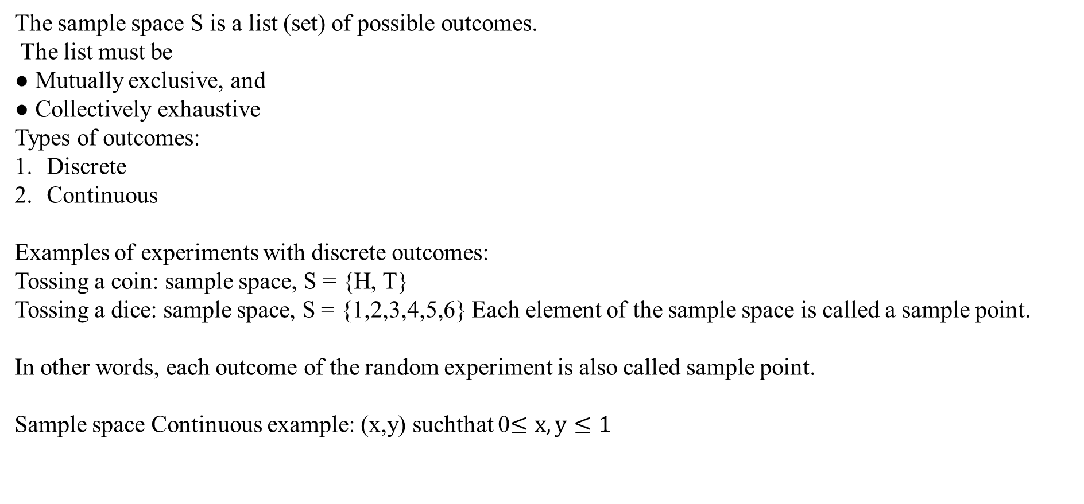
Sample Space
The sample space S is a list (set) of possible outcomes.
The list must be
● Mutually exclusive, and
● Collectively exhaustive
Types of outcomes:
Discrete
Continuous
Examples of experiments with discrete outcomes:
Tossing a coin: sample space, S = {H, T}
Tossing a dice: sample space, S = {1,2,3,4,5,6} Each element of the sample space is called a sample point.
In other words, each outcome of the random experiment is also called sample point.
Sample space Continuous example: (x,y) suchthat 0$≤x,y≤1$

Slide 7
Events
Any subset E of a sample space S is called an event.
Consider the experiment of throwing a dice.
Description of events Corresponding subset of S
the number is exactly 2 A = {2}
the number is an even integer B = {2,4,6}
the number is greater than 6 φ = {}
Occurrence of an event: The event E of a sample space S is said to have occurred if the outcome ω of the experiment is such that ω ∈ E. If the outcome ω is such that ω ∉ E, we say that the event E has not occurred.
In the above example, if the outcome is 6, event B has occurred, and event A has not occurred. On the other hand, if the outcome is 2, both events A and B have occurred.

Slide 8
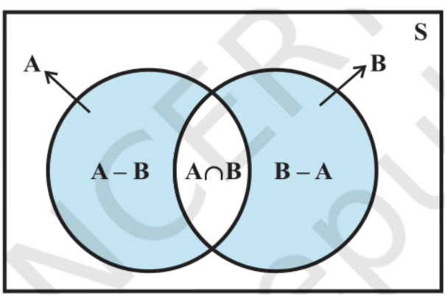
Types of Events
Impossible event : The null set φ={} is called an impossible event
Sure event : S, i.e., the whole sample space is called the sure event.
Simple Event : If an event E has only one sample point of a sample space, it is called a simple (or elementary) event.
Compound Event : If an event has more than one sample point, it is called a Compound event.
We can combine two or more events to form new events.
Let A, B, C be events associated with an experiment whose sample space is S.
Complementary event : For every event A, there corresponds another event A′ called the complementary event to A. It is also called the event ‘not A’.
A′ = {ω : ω ∈ S and ω ∉A} = S – A
A or B A ∪ B = {ω : ω ∈ A or ω ∈ B}
A and B A ∩ B = {ω : ω ∈ A and ω ∈ B}
A but not B A – B = A ∩ B´
source: https://ncert.nic.in/textbook.php?kemh1=16-16

Slide 9
Events
Mutually exclusive events : Two events A and B are called mutually exclusive events if the occurrence of any one of them excludes the occurrence of the other event, i.e., if they can not occur simultaneously. In this case the sets A and B are disjoint.
For example, If A = {2,4,6} and B = {1,3},
A and B are mutually exclusive events.
Exhaustive Events : if E1 , E2 , ..., En are n events of a sample space S and
if E1 ∪ E2 ∪ E3 ∪ ... ∪ En = ∪ Ei = S i = 1 to n then E1 , E2 , ..., En are called exhaustive events.
In other words, events E1 , E2 , ..., En are said to be exhaustive if at least one of them necessarily occurs whenever the experiment is performed.
A partition of a set S is a set of nonempty subsets of S, such that every element x in S is in exactly one of these subsets.

Slide 10



EXAMPLES
1: Tossing a fair coin Two outcomes: Head (H) and Tail (T) Both are equally likely.
2: Tossing a fair dice Set of outcomes = {1,2,3,4,5,6} = sample space All 6 outcomes are equally likely.
3: Mathematics examination grade The likelihood of a student getting first class is smaller than the likelihood of getting pass class.
4: Winner of world cup The likelihood of India winning the next world cup in cricket is …
5: Getting a Tail when tossing a coin is an event
6. Rolling a "5" is an event.
7. An event can include one or more possible outcomes:
8. Choosing a "King" from a deck of cards (any of the 4) is an event
9. Rolling an "even number" (2, 4 or 6) is also an event

Slide 11
SUMMARY
In this session, the basic concepts of probability and its importance have described with the following topics
Difference between Deterministic and Random experiments
Sample space, Sample points, events
Mutually exclusive events, exhaustive event, equally likely events
Different approaches of probability

Slide 12
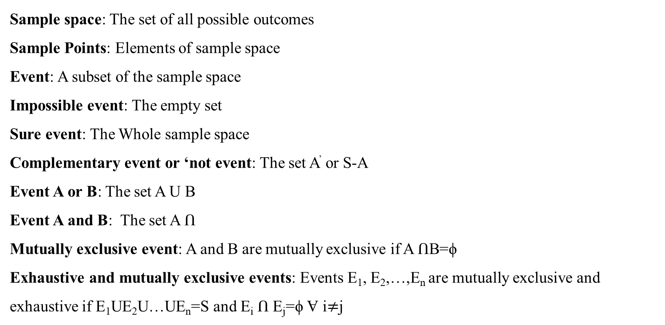
ACTIVITIES/ CASE STUDIES/ IMPORTANT FACTS RELATED TO THE SESSION
Sample space: The set of all possible outcomes
Sample Points: Elements of sample space
Event: A subset of the sample space
Impossible event: The empty set
Sure event: The Whole sample space
Complementary event or ‘not event: The set A’ or S-A
Event A or B: The set A U B
Event A and B: The set A Ո
Mutually exclusive event: A and B are mutually exclusive if A ՈB=ϕ
Exhaustive and mutually exclusive events: Events E₁, E₂,…,E_{n} are mutually exclusive and exhaustive if E₁UE₂U…UE_{n}=S and E_{i} Ո E_{j}=ϕ Ɐ i$≠$j

Slide 13

SELF-ASSESSMENT QUESTIONS
1. We are told that in a random experiment there are five possible outcomes. Which of the following statements is true ?
(a) If, after 20 trials, one outcome has not been observed then the probability that it will occur in the next trial is increased.
(b)nIf, after 20 trials, one outcome has been observed then the probability that it will not occur in the next trial is increased.
(c) If, after 20 trials, one outcome has not been observed then the probability that it will occur in the next trial is unchanged.
(d) If the outcomes are equally likely then the trials are independent.
A coin is tossed 6 times. What is the probability of exactly 2 heads occurring in the 6 tosses.
$\left(6_{c_{2}}\right){(\frac{1}{2})}^{6}$
${(\frac{1}{2})}^{6}$
${(\frac{1}{3})}^{6}$
$\left(6_{c_{2}}\right){(\frac{1}{3})}^{6}$

Slide 14
TERMINAL QUESTIONS
. Describe the concept of Probability and its importance in the various fields with suitable examples.
2. List out the different approaches of Probability
3. If 3 books are picked at random from a shelf containing 5 novels, 3 books of poems, and a dictionary what is the probability that
(a) the dictionary is selected
(b) 2 novels and 1 book of poems are selected
(c) a novel, a book of poems and the dictionary is selected
(d) all three books are novels
4. Summarize the different type of events with examples.

Slide 15
REFERENCES FOR FURTHER LEARNING OF THE SESSION
Reference Books:
1. Chapter 1 of TP1: William Feller, An Introduction to Probability Theory and Its Applications: Volume 1, Third Edition, 1968 by John Wiley & Sons,Inc.
2. Richard A Johnson, Miller& Freund’s Probability and statistics for Engineers, PHI, New Delhi, 11th Edition (2011).
Sites and Web links:
* https://ncert.nic.in/textbook.php?kemh1=16-16 *
Notes: sections 1 to 1.3 of http://www.statslab.cam.ac.uk/~rrw1/prob/prob-weber.pdf
3. https://ocw.mit.edu/courses/res - 6 -012 -introduction -to -probability - spring - 2018/91864c7642a58e216e8baa8fcb4a5cb5_MITRES_6_012S18_L01.pd f 9

Slide 16



